Slide 1
Making Data Driven Decisions

Slide 2
Ground Rules
There is no greater investment then the investment we put into Orphans, Widows, and learning more about our Lord
If you don’t have money for weekly Church contributions, you don’t have money to invest
All data we discuss, is directly from the Federal Reserve Economic Data (FRED.org)
4. This is not a math class

Slide 3
An Inflation Pool Story
Understanding Money Printing

Slide 4
An Empty Pool

Slide 5
If You Add Water
Water Level
The water level rises

Slide 6
If You Add More Water
NEW Level
Original Level
The water level rises again

Slide 7
Key Point!
The pool remained the same size,
So, when you added more water…..
The water level increased

Slide 8
Now Think About Money
Add money to an economy: Prices rise
Add water to a pool: Water level rises
Same idea!

Slide 9
INFLATION
Inflation = When prices go up
because there's more money chasing
the same amount of goods and services’s

Slide 10
How does more money appear?
The Federal Reserve prints money every year.
Example: In 2020, the Federal Reserve printed $3 trillion

Slide 11
THE MATHEMATICS
1. Price Multiplier = Current Price / Historical Price = $324.4 / $260.2 = 1.246471... ≈ 1.25
2. Cumulative Inflation % = (Price Multiplier - 1) × 100 = (1.246471 - 1) × 100 = 0.246471 × 100 = 24.65%
3. Annual Avg Rate % = ((Current Price / Historical Price)^(1/Years) - 1) × 100 = ((1.246471)^(1/5) - 1) × 100 = (1.046617... - 1) × 100 = 4.66%
4. Purchasing Power Today ($) = Historical Amount / Price Multiplier = $10 / 1.246471 = $8.02
5. Purchasing Power Erosion % = (1 - 1/Price Multiplier) × 100 = (1 - 1/1.246471) × 100 = (1 - 0.802265) × 100 = 19.77%
6. Amount Needed Today = Historical Amount × Price Multiplier = $10 × 1.246471 = $12.46

Slide 12
How is inflation affecting your savings?

Slide 13
5 YEARS AGO (November 2020)
Original Amount Saved | Value Today | Loss in Value
$5,000 | $4,011.32 | -$988.68
$10,000 | $8,022.65 | -$1,977.35
$25,000 | $20,056.62 | -$4,943.38
$50,000 | $40,113.24 | -$9,886.76

Slide 14
10 YEARS AGO (November 2015)
Original Amount Saved | Value Today | Loss in Value
$5,000 | $3,658.44 | -$1,341.56
$10,000 | $7,316.87 | -$2,683.13
$25,000 | $18,292.19 | -$6,707.81
$50,000 | $36,584.37 | -$13,415.63

Slide 15
20 YEARS AGO (November 2005)
Original Amount Saved | Value Today | Loss in Value
$5,000 | $3,045.92 | -$1,954.08
$10,000 | $6,091.85 | -$3,908.15
$25,000 | $15,229.62 | -$9,770.38
$50,000 | $30,459.23 | -$19,540.77

Slide 16
30 YEARS AGO (November 1995)
Original Amount Saved | Value Today | Loss in Value
$5,000 | $2,367.68 | -$2,632.32
$10,000 | $4,735.36 | -$5,264.64
$25,000 | $11,838.41 | -$13,161.59
$50,000 | $23,676.81 | -$26,323.19

Slide 17
How is inflation affecting your salary?

Slide 18
5 YEARS AGO (November 2020)
Original Salary | If No Raise | Needed Salary
$50,000 | $40,113.24 | $62,323.57
$65,000 | $52,147.21 | $81,020.64
$80,000 | $64,181.18 | $99,717.71
$100,000 | $80,226.47 | $124,647.14

Slide 19
10 YEARS AGO (November 2015)
Original Salary | If No Raise | Needed Salary
$50,000 | $36,584.37 | $68,335.19
$65,000 | $47,559.69 | $88,835.74
$80,000 | $58,535.00 | $109,336.30
$100,000 | $73,168.75 | $136,670.37

Slide 20
20 YEARS AGO (November 2005)
Original Salary | If No Raise | Needed Salary
$50,000 | $30,459.23 | $82,076.92
$65,000 | $39,597.00 | $106,700.00
$80,000 | $48,734.77 | $131,323.08
$100,000 | $60,918.46 | $164,153.85

Slide 21
30 YEARS AGO (November 1995)
Original Salary | If No Raise | Needed Salary
$50,000 | $23,676.81 | $105,588.54
$65,000 | $30,779.85 | $137,265.10
$80,000 | $37,882.90 | $168,941.67
$100,000 | $47,353.62 | $211,177.08

Slide 22
Inflation will stop at some point, right?

Slide 24
Just as floods and winds test a house's foundation, inflation tests our finances—and when prices outpace paychecks, we discover we've been saving on sand instead of rock. (See Matthew 7:24-26)

Slide 25
So what can I do about all of this?

Slide 26
Let's do what the rich people do!

Slide 27
And invest!

Slide 28
NASDAQ-100:The Nasdaq 100 Index represents the largest 100 nonfinancial companies. Known as QQQM

Slide 29
What is the Nasdaq-100?
• A stock market index of 100 large companies
• Listed on the Nasdaq stock exchange
• Includes tech giants like Apple, Microsoft, Amazon
• Represents about 40% of total US stock market value

Slide 30
The Top 10 Companies You'll Own
1. Apple (AAPL)
2. Microsoft (MSFT)
3. NVIDIA (NVDA)
4. Amazon (AMZN)
5. Meta (META)
6. Alphabet (GOOGL)
7. Tesla (TSLA)
8. Broadcom (AVGO)
9. Costco (COST)
10. Oracle (ORCL)
Plus 90 more innovative companies!

Slide 31
How Do You Actually Buy It?
Popular Nasdaq-100 ETF: QQQM
• Trades like a stock on the market
• Automatically owns all 100 companies
• Professional managers handle everything

Slide 32
What Your $100 Actually Owns
Your money is automatically split across companies:
Apple: $8.50
Microsoft: $7.80
NVIDIA: $7.20
Amazon: $5.40
Other 96 companies: $71.10
Total: $100.00

Slide 33
What are the results of investing?
(Lump Sum)

Slide 34
5 Years Ago (Nov 2020 - Nov 2025)
Initial Amount | Cash Value | Investment Value
$5,000 | $4,011.32 | $10,536.33
$10,000 | $8,022.65 | $21,072.66
$25,000 | $20,056.62 | $52,681.66
$50,000 | $40,113.24 | $105,363.32

Slide 35
10 Years Ago (Nov 2015 - Nov 2025)
Initial Amount | Cash Value | Investment Value
$5,000 | $3,658.44 | $27,187.50
$10,000 | $7,316.87 | $54,375.00
$25,000 | $18,292.19 | $135,937.50
$50,000 | $36,584.37 | $271,875.00

Slide 36
20 Years Ago (Nov 2005 - Nov 2025)
Initial Amount | Cash Value | Investment Value
$5,000 | $3,045.92 | $77,088.61
$10,000 | $6,091.85 | $154,177.22
$25,000 | $15,229.62 | $385,443.04
$50,000 | $30,459.23 | $770,886.08

Slide 37
30 Years Ago (Nov 1995 - Nov 2025)
Initial Amount | Cash Value | Investment Value
$5,000 | $2,367.68 | $177,705.98
$10,000 | $4,735.36 | $355,411.95
$25,000 | $11,838.41 | $888,529.89
$50,000 | $23,676.81 | $1,777,059.77

Slide 38
But what if you do not have a large amount of money to invest but instead, you have small amounts of money monthly?

Slide 39
5 Years Ago (Nov 2020 - Nov 2025)
Monthly Investment | Total Invested | Cash Value | Investment Value
$100 | $6,000.00 | $4,813.59 | $8,567.05
$250 | $15,000.00 | $12,033.97 | $21,417.64
$500 | $30,000.00 | $24,067.94 | $42,835.27
$1,000 | $60,000.00 | $48,135.88 | $85,670.55

Slide 40
10 Years Ago (Nov 2015 - Nov 2025)
Monthly Investment | Total Invested | Cash Value | Investment Value
$100 | $12,000.00 | $8,780.25 | $25,122.44
$250 | $30,000.00 | $21,950.62 | $62,806.11
$500 | $60,000.00 | $43,901.25 | $125,612.22
$1,000 | $120,000.00 | $87,802.50 | $251,224.44

Slide 41
20 Years Ago (Nov 2005 - Nov 2025)
Monthly Investment | Total Invested | Cash Value | Investment Value
$100 | $24,000.00 | $14,620.43 | $70,934.58
$250 | $60,000.00 | $36,551.08 | $177,336.46
$500 | $120,000.00 | $73,102.16 | $354,672.92
$1,000 | $240,000.00 | $146,204.31 | $709,345.84

Slide 42
30 Years Ago (Nov 1995 - Nov 2025)
Monthly Investment | Total Invested | Cash Value | Investment Value
$100 | $36,000.00 | $17,047.30 | $134,021.85
$250 | $90,000.00 | $42,618.26 | $335,054.63
$500 | $180,000.00 | $85,236.52 | $670,109.27
$1,000 | $360,000.00 | $170,473.04 | $1,340,218.53

Slide 43
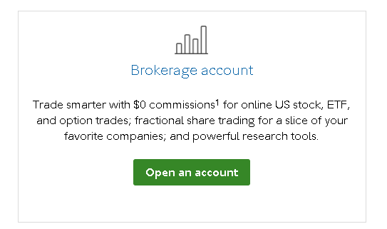
How do you invest?
I use Fidelity

Slide 44
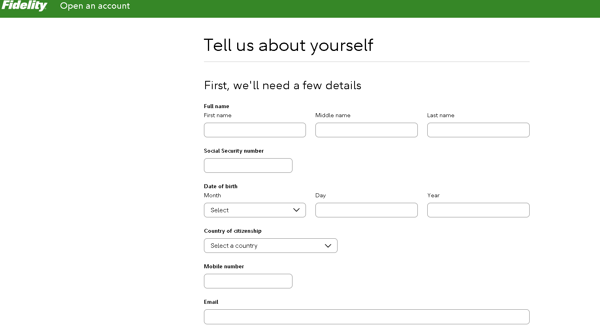
Basic Info

Slide 45
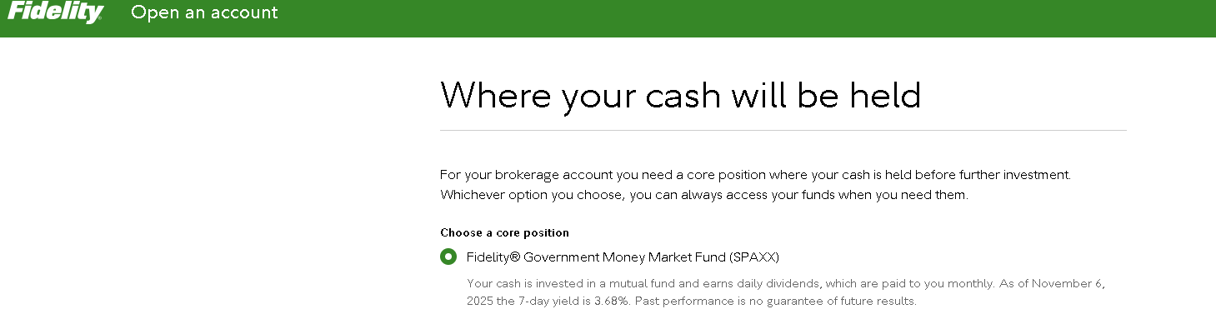

Slide 46
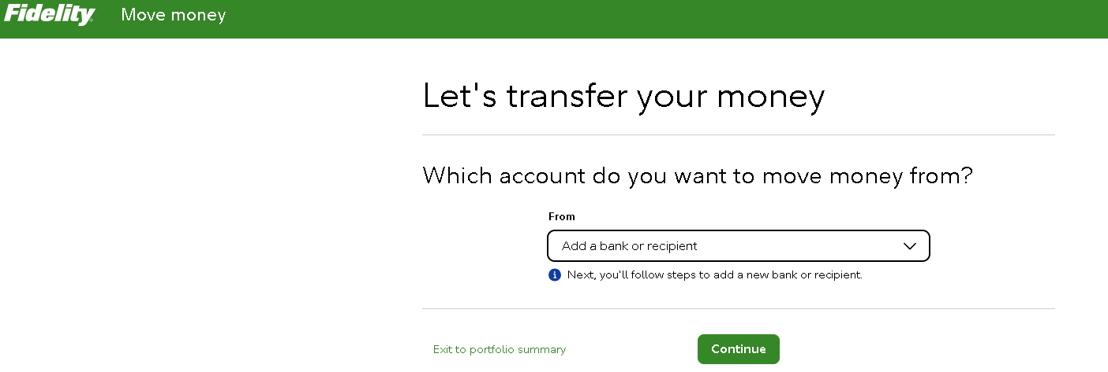

Slide 47
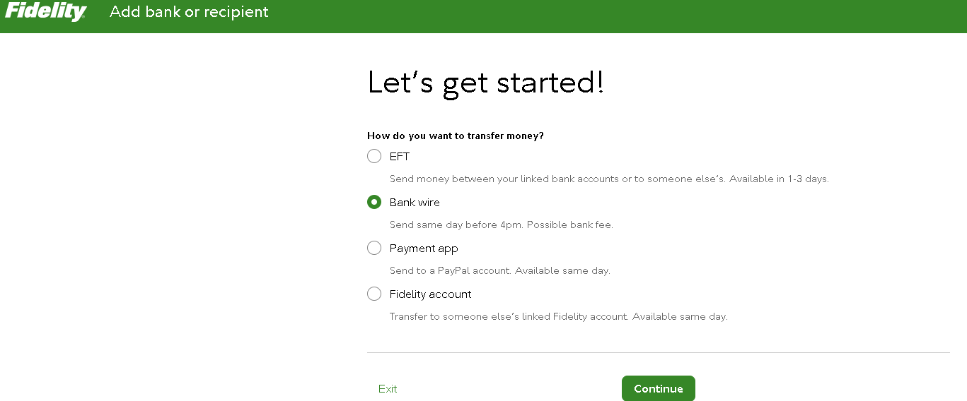

Slide 48
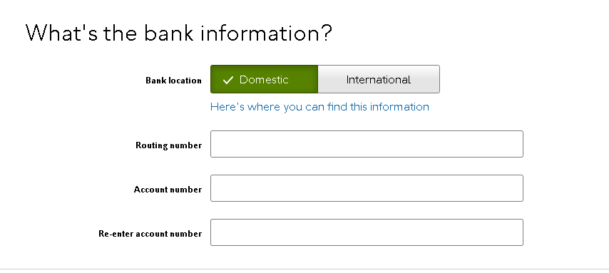

Slide 49
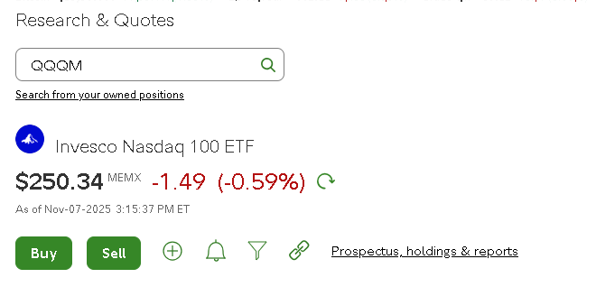
QQQM
Then Click Buy

Slide 50
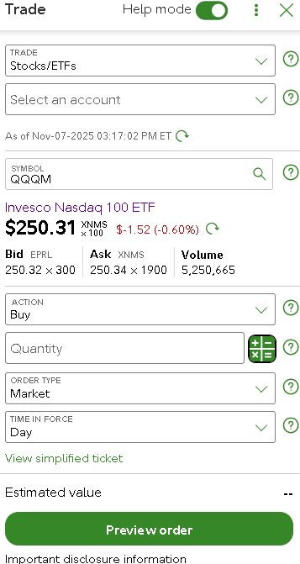

Slide 51
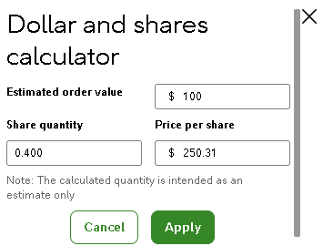

Slide 52
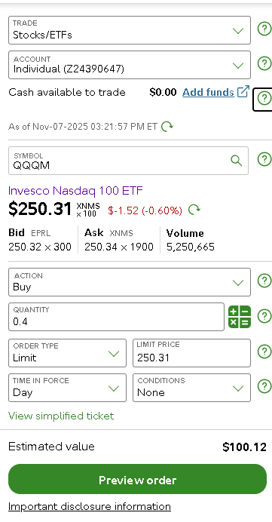

Slide 53
Excuses for why people do not invest

Slide 54
Ohhhhhhh, but I do not understand how the stock market works!

Slide 55
Did you ask to understand how a cell phone worked before buying it?
Did you ask to understand how a vehicles combustible engine worked before buying it?
Please tell me your thoughts regarding drag coefficients on an airplane wing each time you fly.

Slide 56
Ohhhhhhh, but the stock market might drop to zero!

Slide 58
"Dow dives 588 points at close, after historic 1,000-point plunge" Source: CNN Money, August 24, 2015
"Here's Why You Should Expect a 20% Stock Market Crash in 2021" Source: Nasdaq, February 6, 2021
"US stock markets take a major fall as Dow reaches lowest level since August" Source: The Guardian January 15, 2016
"Analysis: The 2021 stock market looks an awful lot like 2000. That's bad news for Big Tech" Source: CNN Business, March 9, 2021
"Analyst: Here Comes the Biggest Stock Market Crash in a Generation" Source: Fortune January 13, 2016
"Is The Stock Market Going To Crash?" Source: Forbes, May 7, 2021
"2018 was was the worst for stocks in 10 years" Source: CNN Business, December 31, 2018
"Bear market confirmed as U.S. stocks' 2022 descent deepens" Source: Reuters, June 13, 2022
"6 factors that fueled the stock market dive in 2018" Source: PBS News, 2018
"Global markets sink after sharp selloff in US bank stocks" Source: CNN Business, March 10, 2023
“Stock Markets, Jolted by Economic Worry, Suffer 2nd Worst Drop of 2019" Source: The New York Times, August 14, 2019
"U.S. Stock Market Sees Biggest Daily Drop in Nearly 2 Years" Source: The New York Times, August 5, 2024
"Dow plummets 1,191 points, worst drop since 2008 financial crisis" Source: CNN, February 27, 2020
"Markets give off 'Black Monday' vibes as stocks tank" Source: Reuters, August 5, 2024

Slide 59
Ohhhhhhh, but I don’t know when the right moment to buy is!

Slide 60
Nobody Does
Time Period | Start Date | Record Highs (Purchases) | Total Invested | Current Value | Total Gain | Return %
YTD 2025 | 2025-01-01 | 43 | $4,300 | $4,614 | $314 | +7.30%
5 Years | 2020-10-31 | 155 | $15,500 | $22,841 | $7,341 | +47.36%
10 Years | 2015-10-31 | 353 | $35,300 | $97,172 | $61,872 | +175.27%
15 Years | 2010-10-31 | 539 | $53,900 | $246,306 | $192,406 | +356.97%
30 Years | 1995-10-31 | 550 | $55,000 | $465,923 | $410,923 | +747.13%
KEY INSIGHT: The data CLEARLY shows you can be the worst investor to ever walk the earth with the worst luck in the history of luck……….AND YOU WILL STILL MAKE MONEY.

Slide 61
Ohhhhhhh, but the value of my home has outperformed the Nasdaq-100!

Slide 62
Are you sure about that?
Scenario | Purchase Amount (Nov 2005) | Value Today (Nov 2025)
Home Value (Inflation-Adjusted) | $200,000 | $328,307.69
NASDAQ Investment | $200,000 | $3,083,544.30
KEY INSIGHT: The data CLEARLY shows investing in the Nasdaq-100 would is a better investment

Slide 63
Ohhhhhh, but someone pay’s me rent on my second home

Slide 64
What does the data say about that?
15-Year Investment Comparison:
Receiving $5,000 a month
Investment | Starting Value | Total Cash Received | Net End Value (accounting for initial investment)
Rental Property | $200,000 | $900,000 | $700,000
NASDAQ-100 | $200,000 | $0 | $2,092,010

Slide 65
How much would you have to charge the renters monthly, just to keep up with the NASDAQ-100?

Slide 66
$11,622.28/Month
GOOD LUCK

Slide 67
Ohhhhhhh, but I do not want to support those crooks on Wall Street

Slide 68
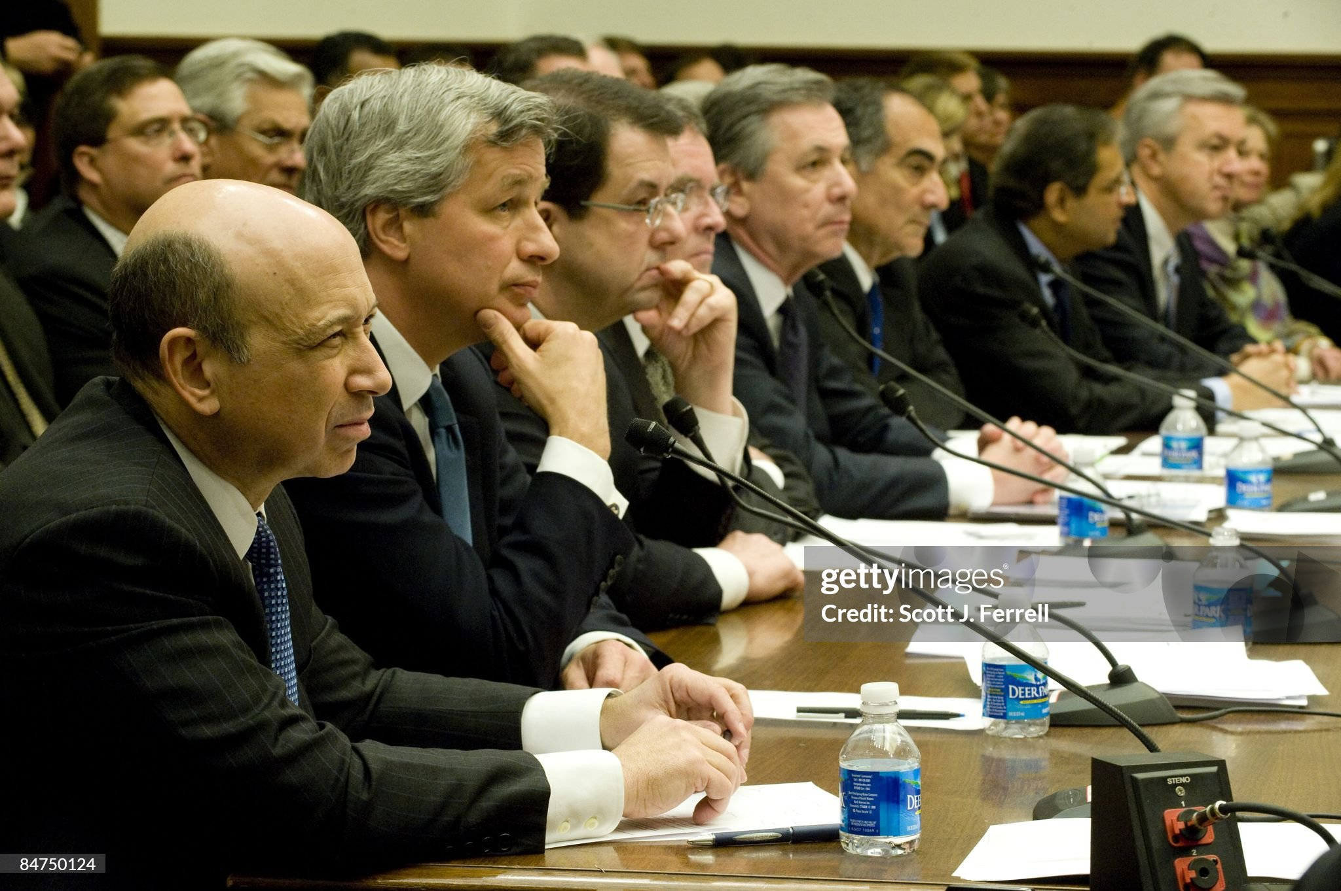
WASHINGTON, DC - Feb. 11, 2009: Lloyd Blankfein, CEO of Goldman Sachs; Jamie Dimon, CEO of JPMorgan Chase and Co.; Robert P.Kelly, CEO of the Bank of New York; Ken Lewis, CEO of the Bank of America; Ronald E. Logue, CEO of State Street; John Mack, CEO of Morgan Stanley; Vikram Pandit, CEO of Citigroup; and John Stumpf, CEO of Wells Fargo, testify during the House Financial Services oversight hearing of the Troubled Assets Relief Program (TARP). (Photo by Scott J. Ferrell/Congressional Quarterly/Getty Images)

Slide 69
Ohhh, but my smart uncle told me not to invest!

Slide 70
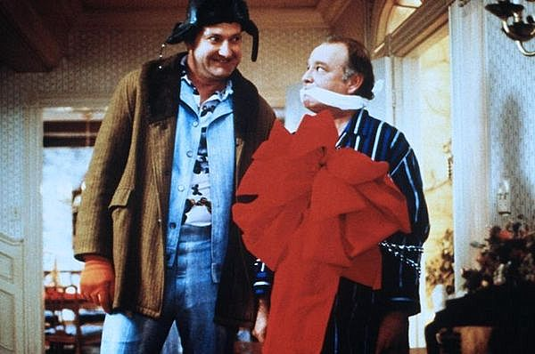

Slide 71
The list goes on.

Slide 72
The data clearly shows what the long-term wise decision is.

Slide 73
Perhaps you should listen to the data

Slide 74
Thank you!

